Slide 1
Final project
Analysis on expected credit score based on income, profession and other data
Members:
Berta Devenyi
Richard Luong
Robert McDonald
Steve B
Johan Ehrhardt

Slide 2
Definition of the problem
We are working with a company that has collected basic bank details and gathered a lot of credit-related information. The company is currently seeking help to build an easier solution on how to display all this information providing helpful insights on a timely manner. First, the information requires a lot of manual effort in order to build an intelligent system to segregate the people into credit score brackets. Given a person’s credit-related information, we aim to build a machine learning model that can classify the credit score.

Slide 3
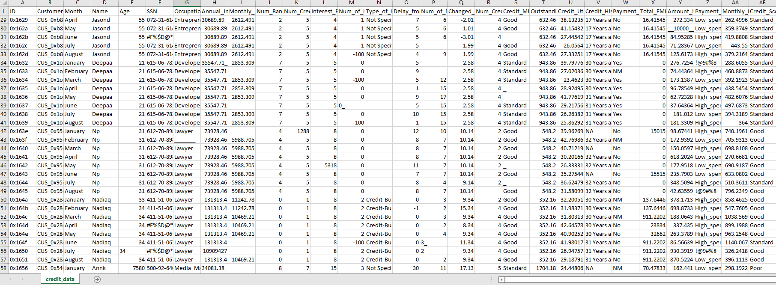
Credit Data

Slide 4
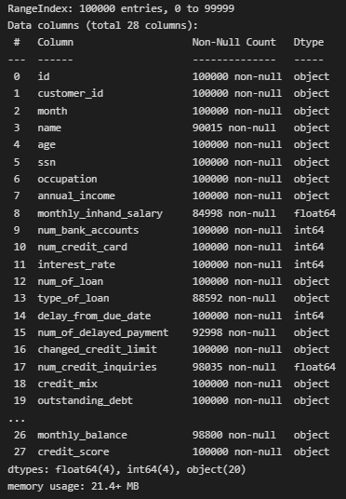
Data cleaning process
We used Pandas for this process.
Basic formatting for ease of use/prevent errors
a. A lowercase heading was applied to the data set
3. Get an understanding of the Data

Slide 5
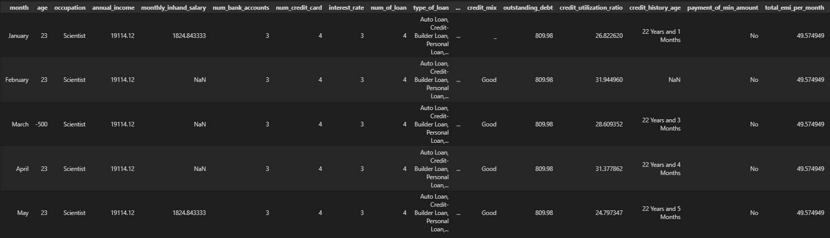
Data cleaning process
We dropped the columns that were not necessary. Such as ‘Person’s ID’, ‘Customer_ID’, ‘Name’ and ‘SSN’

Slide 6
Data cleaning process
Preprocessing:
a. Working through each columns to understand anomalous values, and alter or delete as appropriate.
6. Convert the data included in some columns into the correct format for the Machine Learning calculations during the next stage of the process.
Drop redundant columns.
Remove values that were not required.

Slide 7
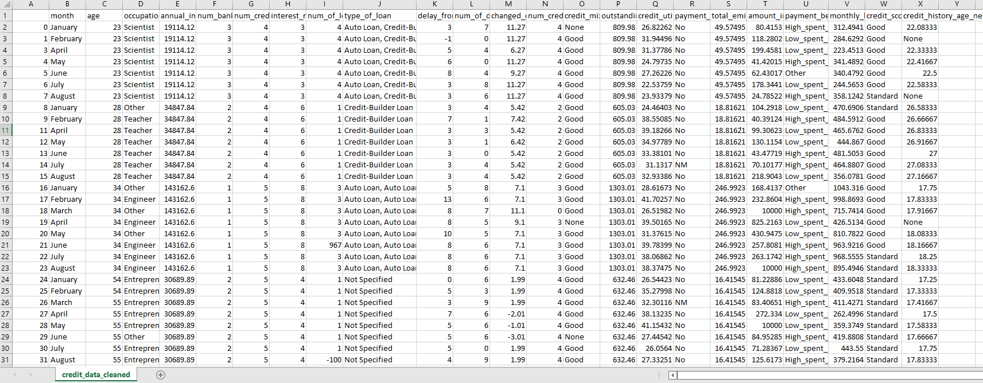
Credit Data cleaned

Slide 8
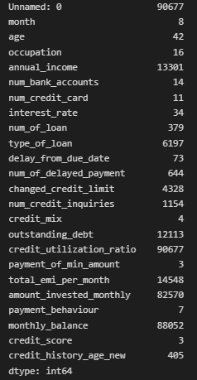
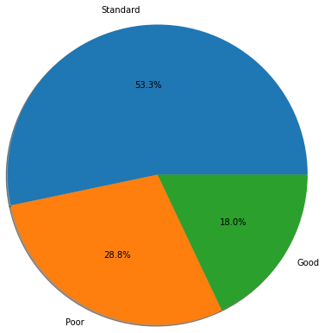
Machine learning analysis

Slide 9

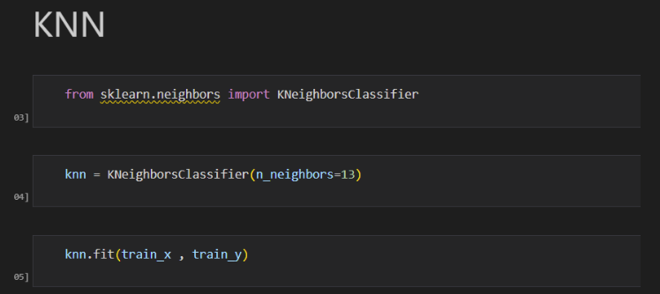
Machine learning analysis
Create training and testing data.
Fit the model to the training data and calculate training and testing data scores
Create a KNN model

Slide 10
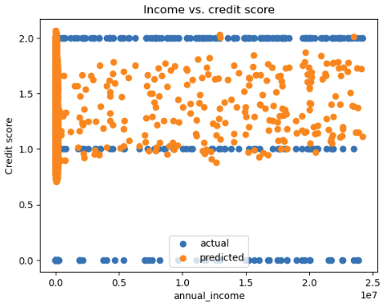
Income Vs credit score

Slide 11
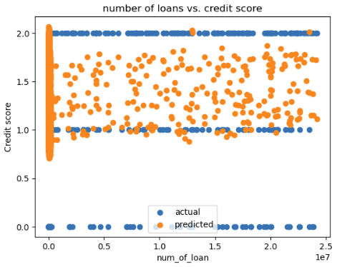
Number of loans Vs credit score

Slide 12
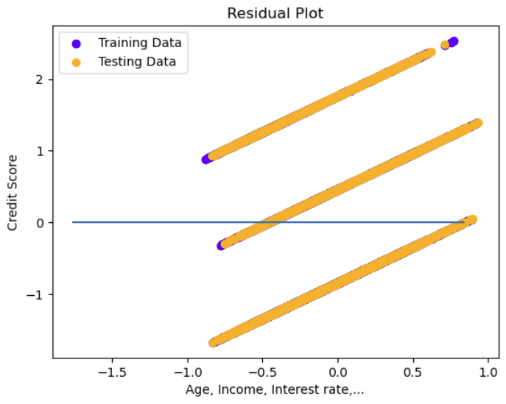
Residual plot

Slide 13
Tableau

Slide 14
Tableau

Slide 15
Tableau

Slide 16
Tableau

Slide 17
heroku

Slide 18
Thanks!

